Slide 1

Select Topics in Python Errors and Exceptions
Notes:
‹#›

Slide 2

Objectives
Objectives:
Discover the types of errors.
Use exceptions.
Notes:
‹#›

Slide 3

Types of Error
Errors
Syntax error.
Semantics error.
Run time error.
Logical error.

Slide 4
Types of Error
Syntax error
Syntax errors: refers to formal rules governing the construction of valid statements in a language.
Syntax errors occur when rules of a programming language are misused, i.e., when a grammatical rule of the language is violated.

Slide 5
Types of Error
Semantics errors
Semantics errors occur when statements are not meaningful.
Semantics refers to the set of rules which give the meaning of the statement.
Examples:
Jon is registered for a class.
It is semantically and syntactically correct.
Class registered a class for Jon.
Incorrect and not Semantically correct.
Notes:
is syntactically correct (syntax is correct) but semantically incorrect. Similarly, there are semantics rules of programming language, violation of which results in semantical errors.
X * Y = Z
will result in semantical error as an expression can not come on the left side of an assignment statement.
‹#›

Slide 6
Types of Error
Run time errors
A run time error occurs during the execution of a program. It is caused when an illegal operation has taken place.
As an example:
Open/write to a file.
Divide by zero.

Slide 7
Types of Error
Logical errors
A logical error causes a program to produce an incorrect or undesired output.
As an example:
Infinite loops
Mathematical operation.
Notes:
‹#›

Slide 8
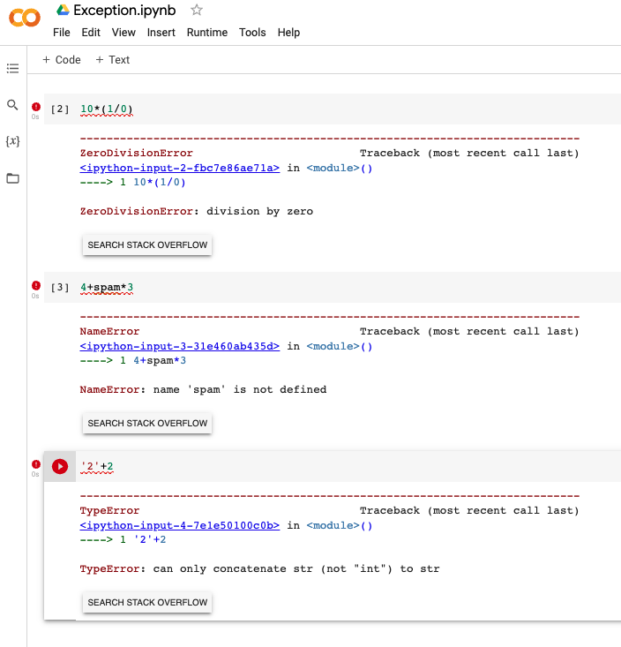
Exceptions
What is an exception?
Even when a statement or expression is syntactically correct, it may cause an error when an attempt is made to execute it.
An error during this process is called an exception.
Notes:
‹#›

Slide 9
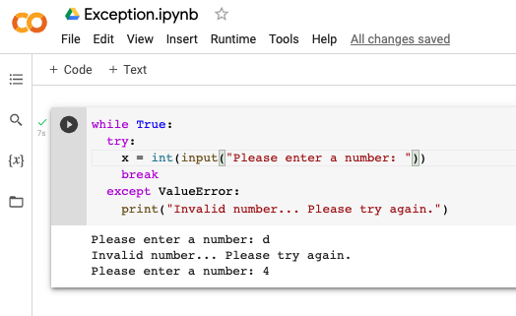
Handling Exceptions
It is possible to write programs that handle selected exceptions. Look at the following example, which asks the user for input until a valid integer has been entered, but allows the user to interrupt the program using Control-C or whatever the operating system supports. Note that a user-generated interruption is signalled by raising the KeyboardInterrupt exception.
Notes:
First, the try clause (the statement(s) between the try and except keywords) is executed.
If no exception occurs, the except clause is skipped and execution of the try statement is finished.
If an exception occurs during execution of the try clause, the rest of the clause is skipped. Then if its type matches the exception named after the except keyword, the except clause is executed, and then execution continues after the try statement.
‹#›

Slide 10
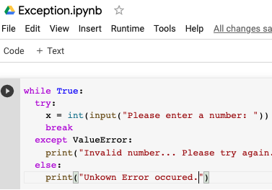
Exception Clause with No Excepptions
This kind of a try-except statement catches all the exceptions that occur. Using this kind of try-catch statement is not considered a good programming practice, because but catches all exceptions butt doesn’t make the programmer identify the root cause of the problem that occurred.
Notes:
‹#›

Slide 11
Common Exceptions
IOError
Raised when the file cannot be opened.
ImportError
Raised when Python cannot find the module.
ValueError
Raised when a built-in operation or function received an argument that has the right type but an inappropriate value.
KeyboardInterrupt
Raised when the user hits the interrupt key.
EOFError
Raised when one of the built-in functions(input() or raw_input()) hits an end-of-file without reading data.

Slide 12
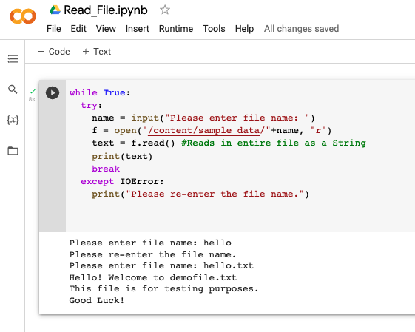
Reading File
Errors
Notes:
‹#›

Slide 13
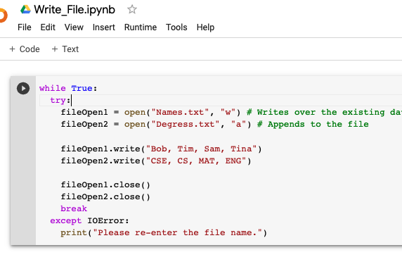
Write File
Errors
Notes:
‹#›

